Slide 1
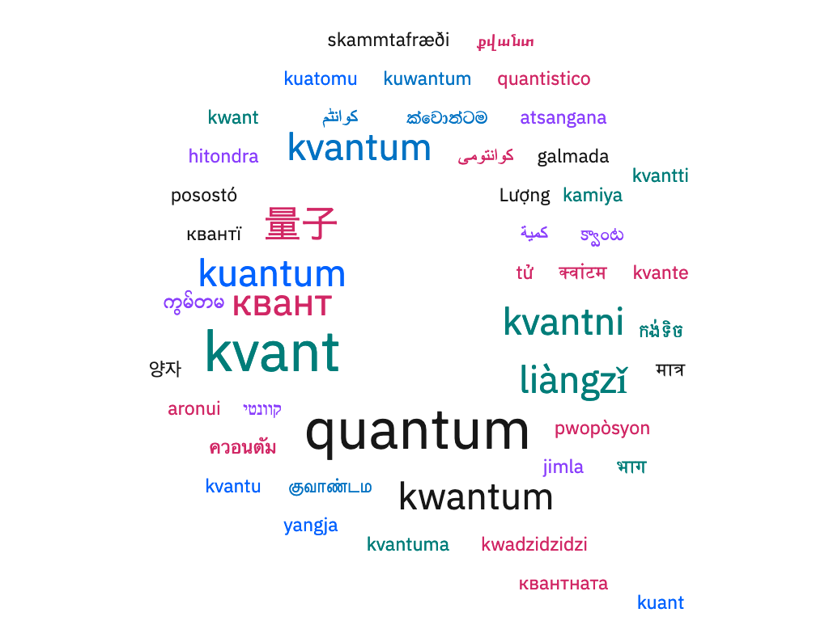
Qiskit Localization Onboarding Guide
Making Qiskit Textbook accessible to everyone
#QiskitLlocalization
September, 2022
Localization Core Team: Soolu Thomas, Sophy Shin, Claudia Zendejas-Morales and Yuri Kobayashi
Notes:
Hi everyone, my mame is Yuri Kobayashi, I am part of the localization core team and I am here today to give you an update about on the much anticipated Qiskit Textbook Localization Project.

Slide 2
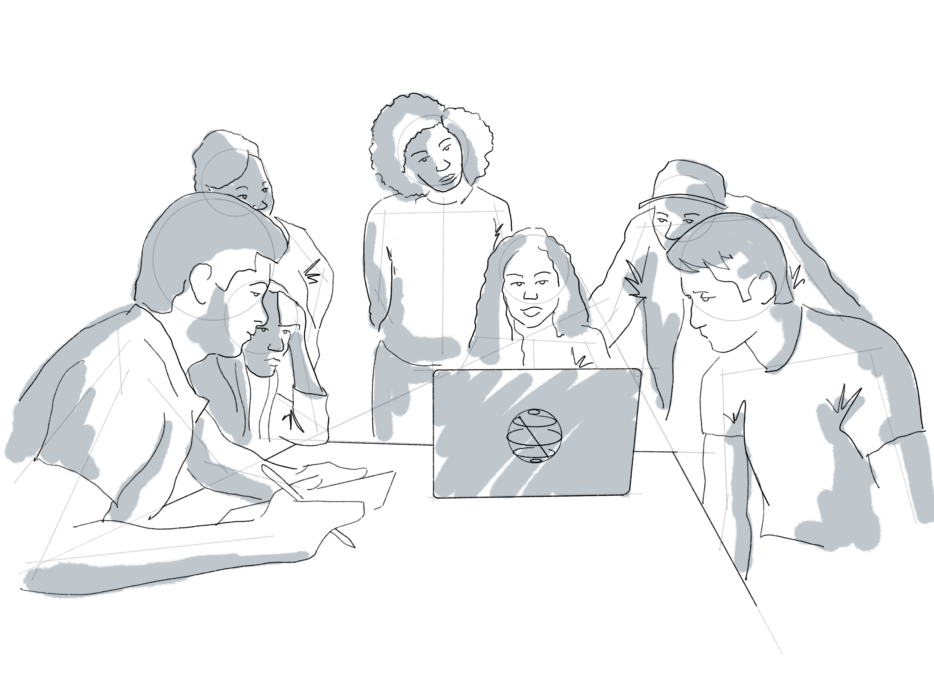
Why Localization?
76% of internet users prefer to read product information in their native language.
Christa Zoufal Quantum Applications Researcher IBM Research - Zurich
Data Source: CSA Research
Notes:
Question for audience

Slide 3
More Facts & Figures
There are 743 million non-native speakers (those who speak English as their second language) in the world.
Only 4 percent of the conversations happening in the world involve native English speakers.
Even among people with high proficiency in English, 65% prefer content in their native language.
Data Source: CSA Research, Ethnologue,

Slide 4
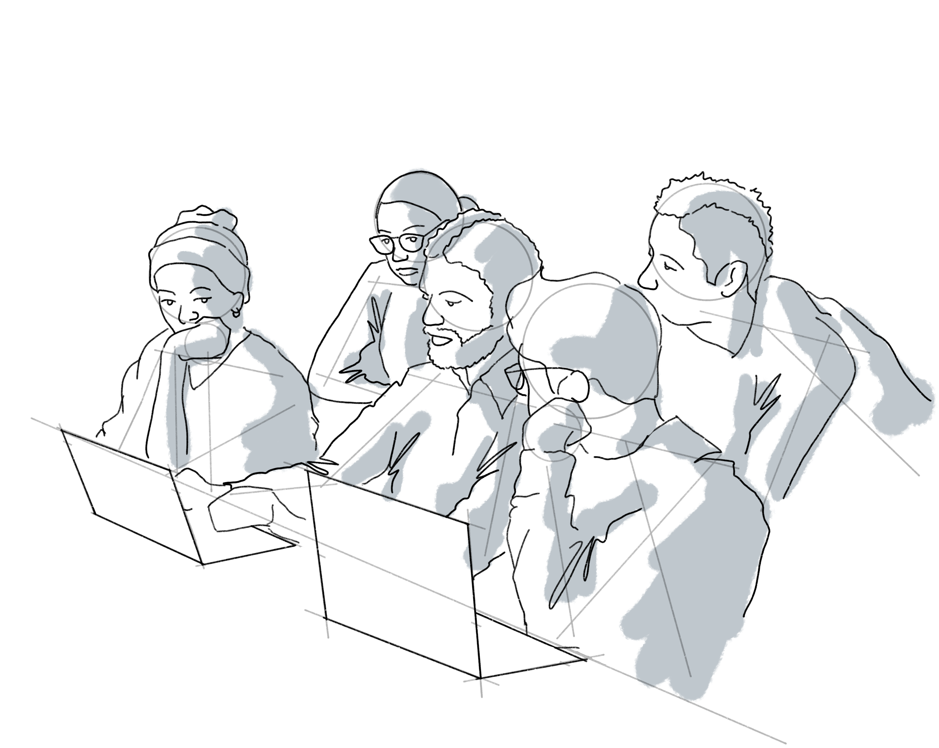
Our Mission
Help make Qiskit accessible to non- English speaking communities
Christa Zoufal Quantum Applications Researcher IBM Research - Zurich
Notes:
Question for audience

Slide 5


About Qiskit Docs Localization Project
Qiskit Docs Localization project aims to help make Qiskit and its related documentation accessible to non-English speaking communities. Clear, readable, easy to understand documentation is key to any adoption of new technology and we do not want language to be the barrier. Through the open-source spirit of our community members, we currently have over 350 volunteer translators representing 22 different languages supported in our localization project.
260+ Localization Contributors
22 Languages (Bengali, Chinese Simplified, Chinese Traditional, French, Germany, Greek, Hindi, Indonesian, Italian, Japanese, Korean, Malayalam, Marathi, Polish, Portuguese, Russian, Spanish, Swahili, Tamil, Thai, Turkish, Vietnamese) supported (*as of Sep 2022)
Two localization platforms (Crowdin & GitLocalize) that streamlines the process

Slide 6
Qiskit Localization
Qiskit Localization currently has two translation projects: (1) Qiskit Documentation and (2) Qiskit Textbook (beta) – these projects are managed under a separate project repo on GitHub.
 | Qiskit Documentation | Textbook (beta)
Home | https://qiskit.org/documentation/ | https://qiskit.org/learn/
Main Repo | https://github.com/qiskit-community/qiskit-translations | https://github.com/Qiskit/platypus
Translation Tool (Localization Platform) | Crowdine | GitLocalize
How to Join | https://github.com/qiskit-community/qiskit-translations/blob/master/README.md | https://github.com/Qiskit/platypus/blob/main/TRANSLATING.md
Must sign up to either one or both depending on what project you want to work on.
Christa Zoufal Quantum Applications Researcher IBM Research - Zurich
Notes:
Question for audience

Slide 7
How to join Documentation Project

Slide 8
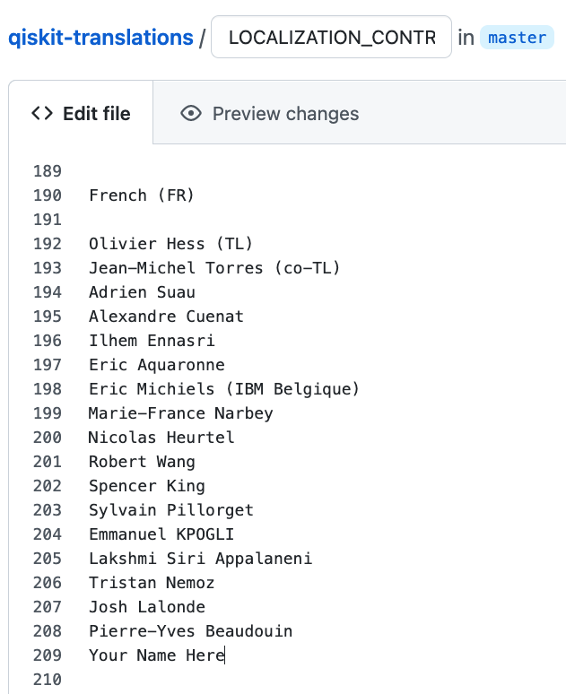
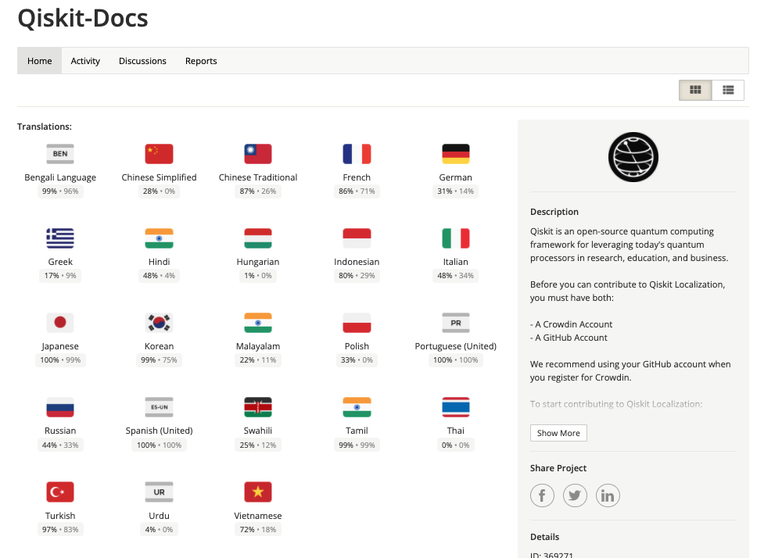
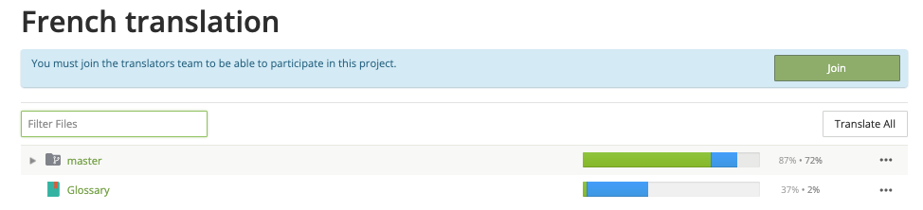
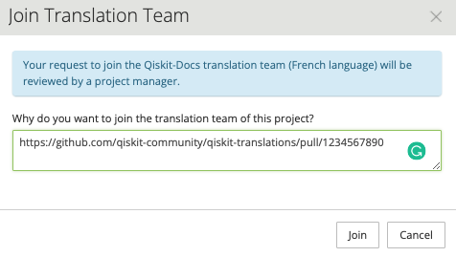
How to join Documentation project
Create a pull request (PR) in this repo by adding your name in LOCALIZATION_CONTRIBUTORS.
Sign the CLA (Contributors License Agreement) if this is the first time you are contributing to Qiskit.
With your GitHub ID, login to Qiskit-Docs Crowdin and join the language you want to contribute to.
Paste the PR url(e.g. https://github.com/qiskit-community/qiskit-translations/pull/###)
Project admins or translation leads will review/approve/merge your original PR.
Add your name and create a PR
Join language in Crowdin by pasting the PR url
Join
Choose language
Paste url of your PR
Christa Zoufal Quantum Applications Researcher IBM Research - Zurich
GitHub
Crowdin
8
Notes:
Question for audience

Slide 9
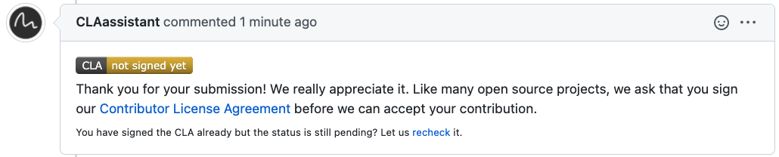


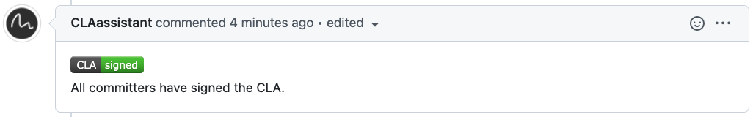
First time contributing to Qiskit?
If this is your first time contributing to Qiskit or to the Qiskit Textbook Localization project, after opening a Pull Request (PR) to add your name to the LOCALIZATION_CONTRIBUTOR list, you will be prompted to sign the Contributor License Agreement (CLA).
Click on the CLA link and sign in with GitHub ID to agree
Make sure you see the CLAassitant leave the comment below that you have properly signed the CLA

Slide 10
How to join Textbook (beta) Project

Slide 11

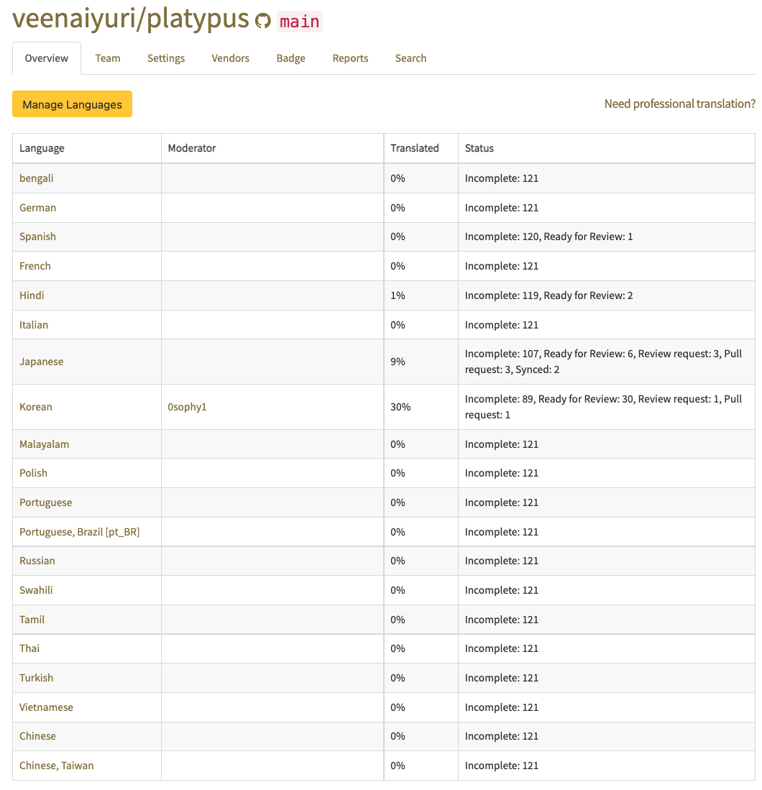
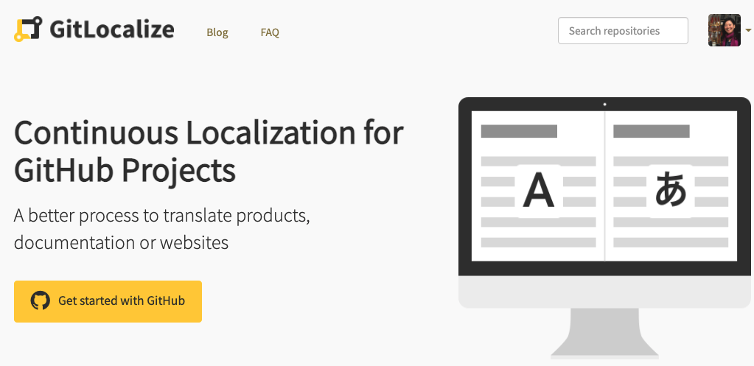
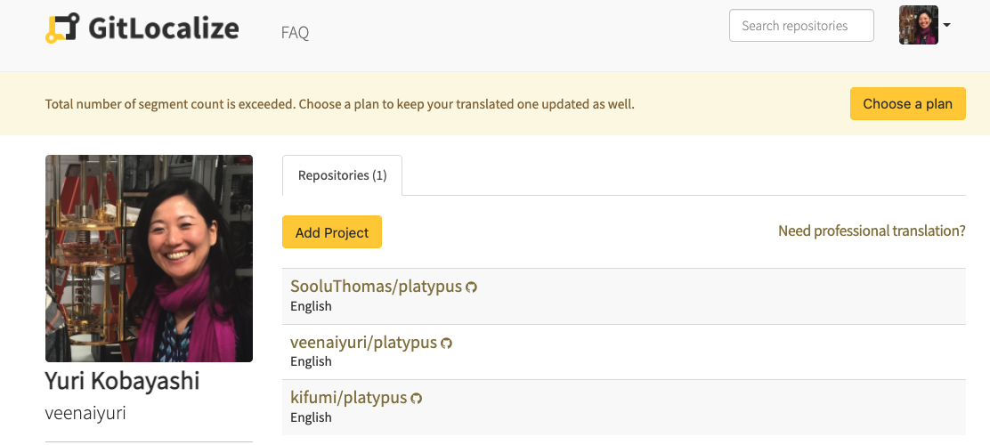
How to join Textbook (beta) Project
Create a pull request (PR) in platypus repo by adding your name in LOCALIZATION_CONTRIBUTOR.
Sign the CLA (Contributors License Agreement) if this is the first time you are contributing to Qiskit.
Join GitLocalize and leave comment in your PR that you successfully joined (see next slide for details)
Once your PR is accepted and merged you will receive notification from GitLocalize.
Join project Qiskit/platypus and choose your language and start translating.
Receive notification from GitLocalize
Choose language & translate
①Create PR and ②sign the CLA
④Leave comment in PR that you joined GitLocalize
⑤Join Qiskit/platypus in GitLocalize and choose lang.
③Join GitLocalize
Enter Qiskit/platypus project
GitHub
11
Notes:
Question for audience

Slide 12
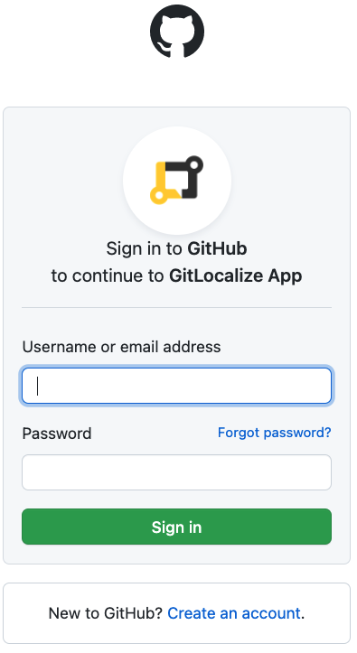
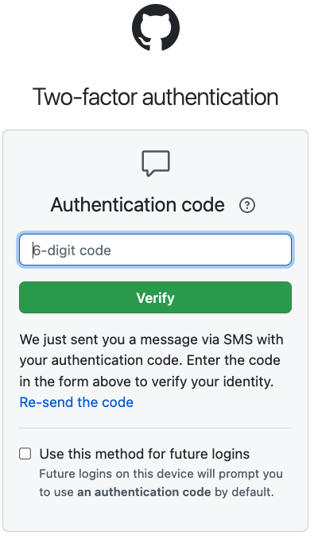
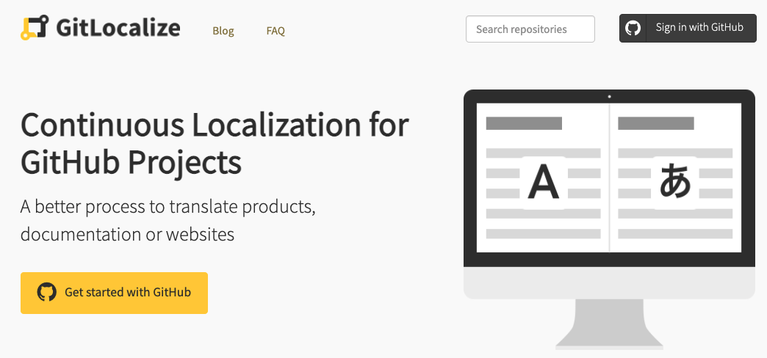
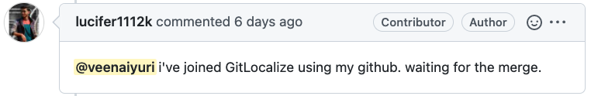
Sign into GitLocalize with your GitHub ID
②Sign in with GitHub ID
③Verify auth code and join
①Go to gitlocalize.com
Let us know in the comments after you joined

Slide 13
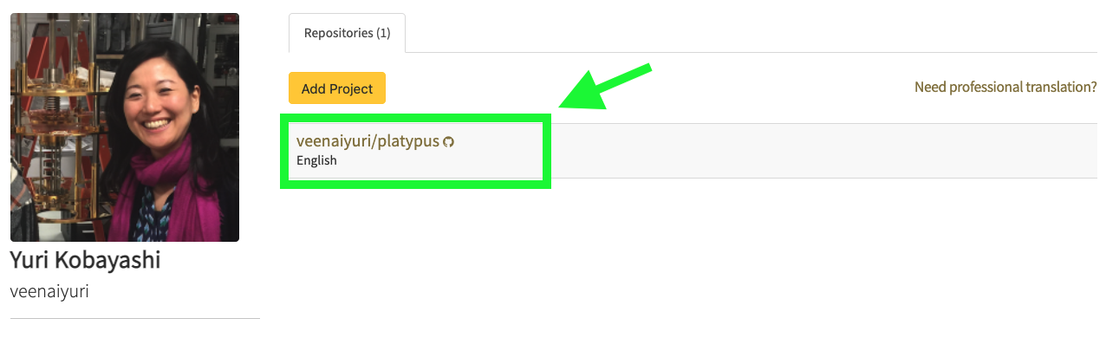
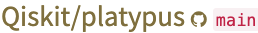
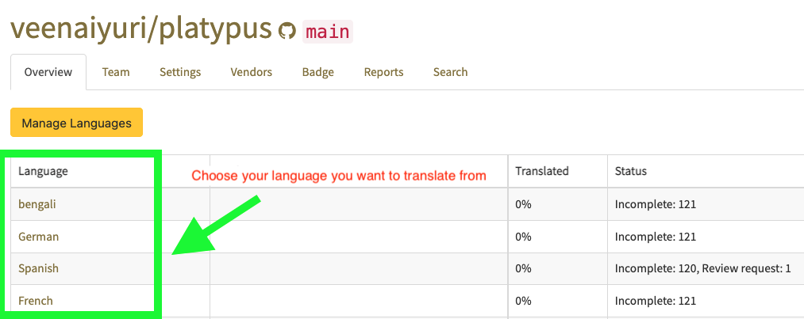
Choose platypus project and your language
Choose Qiskit/platypus
Choose your language

Slide 14
Roles & Responsibilities

Slide 15



Roles & Responsibilities
Translation Lead (can also double or triple as translator and proof-reader)
Responsible for overseeing and motivating the team by sharing progress, setting directions, expectations, and recognizing good practices.
Proof—reader (can also be a translator)
A proof—reader should be someone who not only is proficient in the language but also has basic knowledge of quantum computing and Qiskit who can make suggestions for quality translations.
Translator (which can also double as proof-reader)
A translator must be proficient enough in the language to ensure the text is translated in context of the original source material.
Notes:
Question for audience

Slide 16
Translation Lead
Translation Lead (can also double as translator or proof-reader)
Responsible for overseeing and motivating the team by sharing progress, setting directions, expectations, and recognizing good practices.
Main responsibilities
Qiskit Docs TL Sync: Join Bi-weekly meetings (every other Tuesday 9:30am EST) where we share updates, progress, best practicies, priorities and relavant topics related to localization.
Share priorities with your team in your dedicated language slack channel
Track progress in our project airtable at least once every two weeks https://airtable.com/appKYFb9qp6Ac1inz/tblJl2j7Tst77nXY1/viwQbszDehG7EDLaL?blocks=hide
Notes:
Question for audience

Slide 17
Team Collaboration

Slide 18
Communication Tools
Please join Qiskit Slack (https://qiskit.slack.com/ssb/redirect)
Search and join # qiskit-localization where you can ask anything related to Qiskit Localization
Send your slack handle to @Sophy, @Soolu, or @Yuri Kobayashi via Qiskit Slack
We will add you to the 🔒 qiskit-docs-yourlanguage channel for your team to discuss translations related to your target language

Slide 19
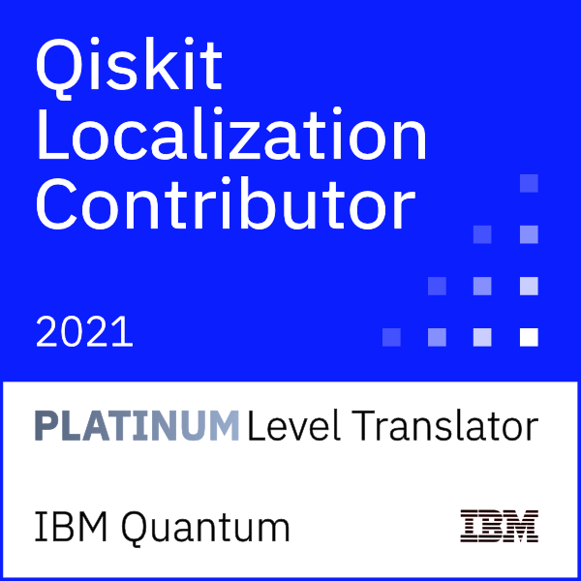
Contribute and earn your badge
Apply Here↓
https://ibm.biz/qiskit-docs
You can earn a badge through your localization contributions to the Qiskit and quantum community .
Qiskit-Docs Localziation Contributor Platinum Level Badge Image
Bronze Level – 5,000 words translated and/or approved Silver Level - 8,000 words translated and/or approved Gold Level – 15,000 words translated and/or approved Platinum Level – 25,000 words translated and/or approved
Christa Zoufal Quantum Applications Researcher IBM Research - Zurich
Notes:
Question for audience

Slide 20
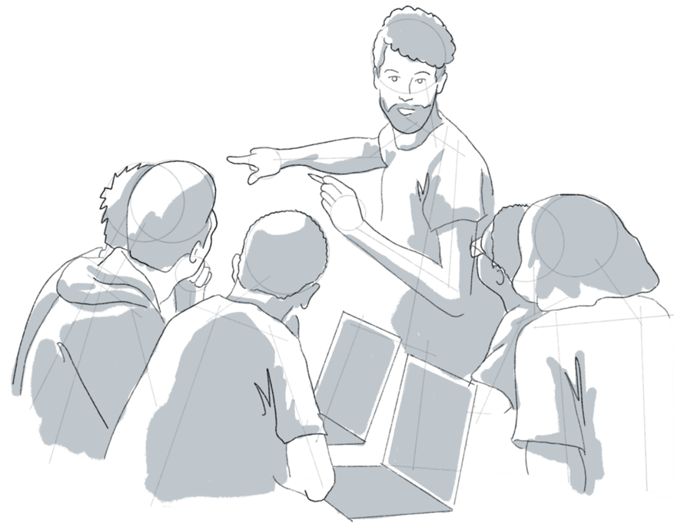
IBM Quantum Community Code of Conduct
In our collective mission to continue to promote and encourage an inclusive and welcoming global quantum community, The IBM Quantum Community Code of Conduct is available for download and review here. We appreciate everyone's support in this mission and ask that any observed code of conduct violations or inappropriate behavior be reported here.
[ Read Code of Conduct ]

Slide 21
Translate Responsibly
In addition to the IBM Quantum Community Code of Conduct, the Qiskit Localization Project values the following standards which are applicable in the context of community translation efforts.
Examples of translating responsibly:
Being mindful of the context when translating (having the original source material available to be referenced frequently is highly recommended).
Focusing on the quality of translations above quantity
Engaging in collaboration and valuing opinions and suggestions from other translators
Using tools such as the Sphinx editor and Staging site to check and correct syntax errors before accepting translations
Examples of irresponsible acts or translating may include:
Copy pasting other’s translation work
Blindly accepting translations without careful quality check
Abuse of machine translation with no regard to its translation quality
Other conduct which could be reasonably be considered inappropriate
[ Read Code of Coduct ]

